Slide 1
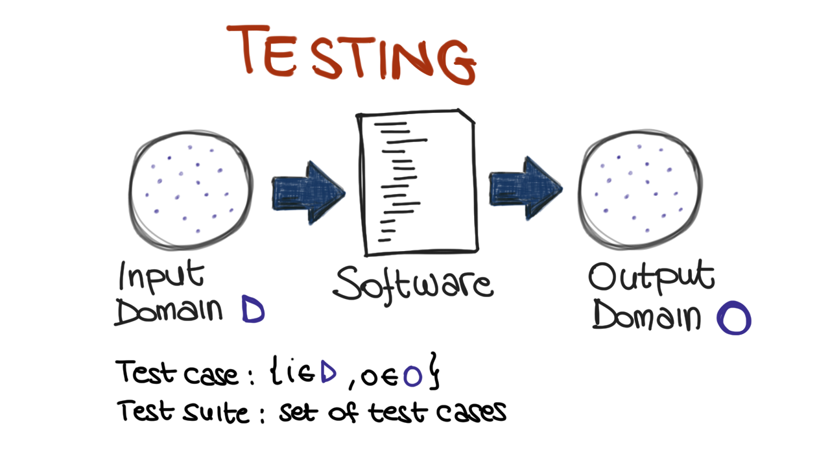
Notes:
Pros: no false positives
Limits: incomplete

Slide 2
Notes:
Pros: no false positives
Limits: incomplete

Slide 3
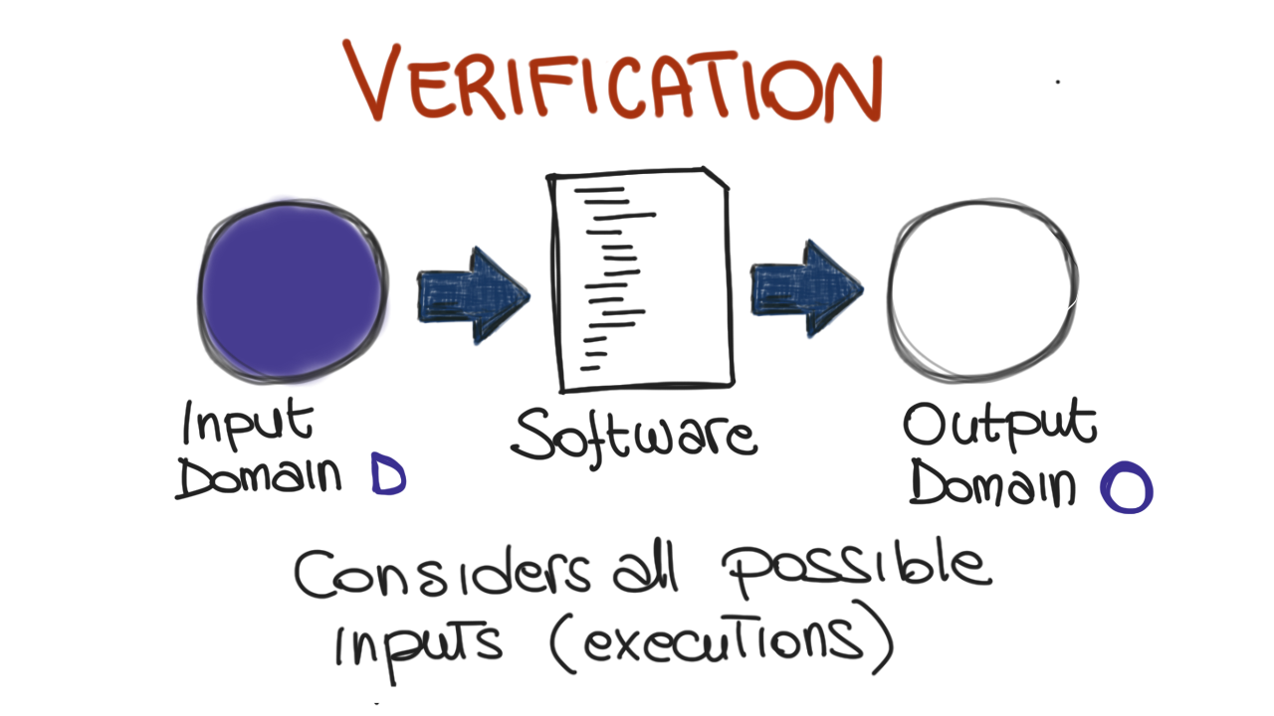
Notes:
Pros: considers all possible behavior
Cons: generates false positive

Slide 4
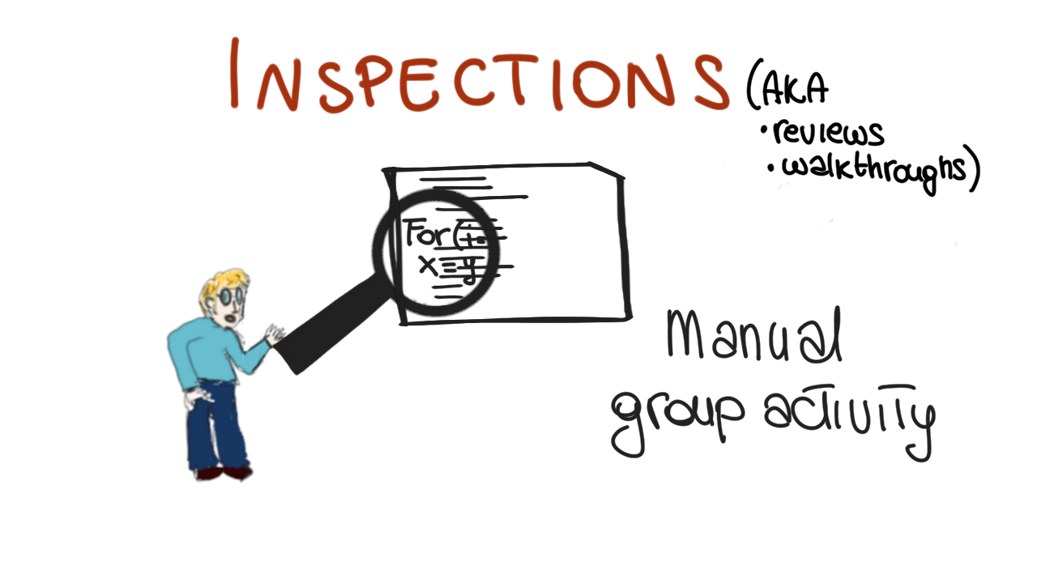
Notes:
Pros: systematic, thorough
Cons: subjective, informal

Slide 5
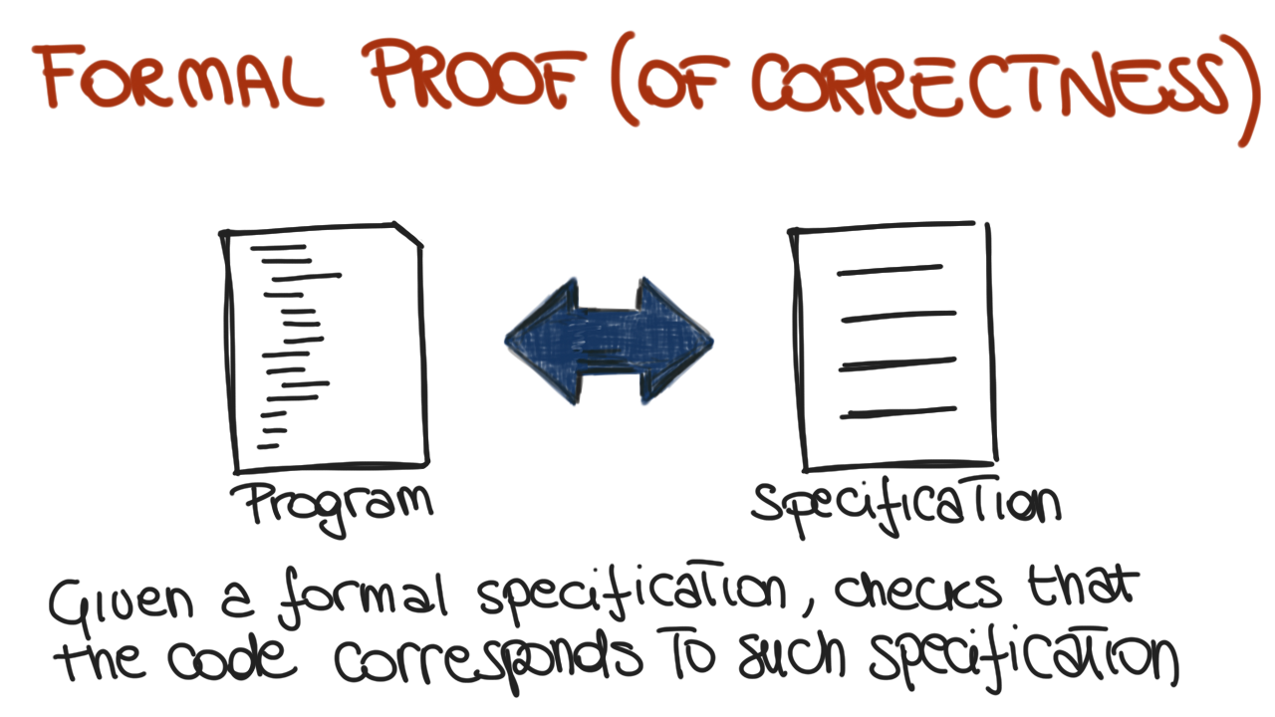
Notes:
Pros: strong guarantees
Cons: complex, expensive

Slide 6
Testing

Slide 7
What is Testing?
Testing == To execute a program with a sample of the input data
Notes:
A test is successful when the program fails

Slide 8
Notes:
Pros: no false positives
Limits: incomplete

Slide 9
What is Testing?
Testing == To execute a program with a sample of the input data
Dynamic technique: program must be executed
Notes:
A test is successful when the program fails

Slide 10
RIPR Model
Reachability
Infection
Propagation
Revealability
Test
Final Program State
Observed Final Program State
Reaches
Fault
Incorrect Final State
Infects
Incorrect Program State
Propagates
Reveals
Test Oracles
Notes:
The failures can be revealed when the observed final program state has overlap with the incorrect final program state.
The question is: should testers check the entire program state? How to observe the incorrect program state in a cost-effective manner.
Getting the overlap as big as possible and use the cost as small as possible.

Slide 11
What is Testing?
Testing == To execute a program with a sample of the input data
Dynamic technique: program must be executed
Optimistic approximation:
The program under test is exercised with a (very small) subset of all the possible input data
(We assume that the behavior with any other input is consistent with the behavior shown for the selected subset of input data)
Notes:
A test is successful when the program fails

Slide 12
All input data?
How long would it take (approximately) to test exhaustively the following program?
printSum(int a, int b) {…}
2³² x 2³² = 2⁶⁴ =~ 10¹⁹ tests
Assume 1 test per nanosecond (10⁹ tests/sec)
we get 10¹⁰ seconds…
About 600 years!
Notes:
After learning they can’t do the job right, it takes some testers a while to learn how to do the job well

Slide 13
Software Testing Foundations
Testing can only show
the presence of failures
(and so faults in the code),
but not their absence

Slide 14
Testing Goals Based on Test Process Maturity
Level 0: No difference between testing and debugging
Level 1: The testing purpose is to show correctness
Level 2: The testing purpose is to show that the software does not work
Level 3: The testing purpose is to reduce the risk of using the software
Level 4: Testing is a mental discipline that helps all IT-related professionals develop higher quality software

Slide 15
Testing and Debugging
Testing: Evaluating software by observing its execution
Test Failure: Execution of a test that results in a software failure
Debugging: The process of finding a fault given a failure

Slide 16
Testing Goals Based on Test Process Maturity
Level 0: No difference between testing and debugging
Level 1: The testing purpose is to show correctness
Level 2: The testing purpose is to show that the software does not work
Level 3: The testing purpose is to reduce the risk of using the software
Level 4: Testing is a mental discipline that helps all IT-related professionals develop higher quality software
Always advocate for Level 4
Notes:
Level 1: Correctness is impossible to achieve. What do we know if no failures? Good software or bad tests?
Level 2: Looking for failures is a negative activity. Puts testers and developers into an adversarial relationship
Level 3: Testers and developers cooperate to reduce risk
Level 4: Testing is only one way to increase quality

Slide 17
To do…
Have a plan
Remember that there are different level of granularity
Remember that there are different moment in the development process
Know why you are running a test case?
Know your goals
Coverage level
When to stop
Notes:
… test until the ship-date …
Sometimes called the “date criterion”

Slide 18
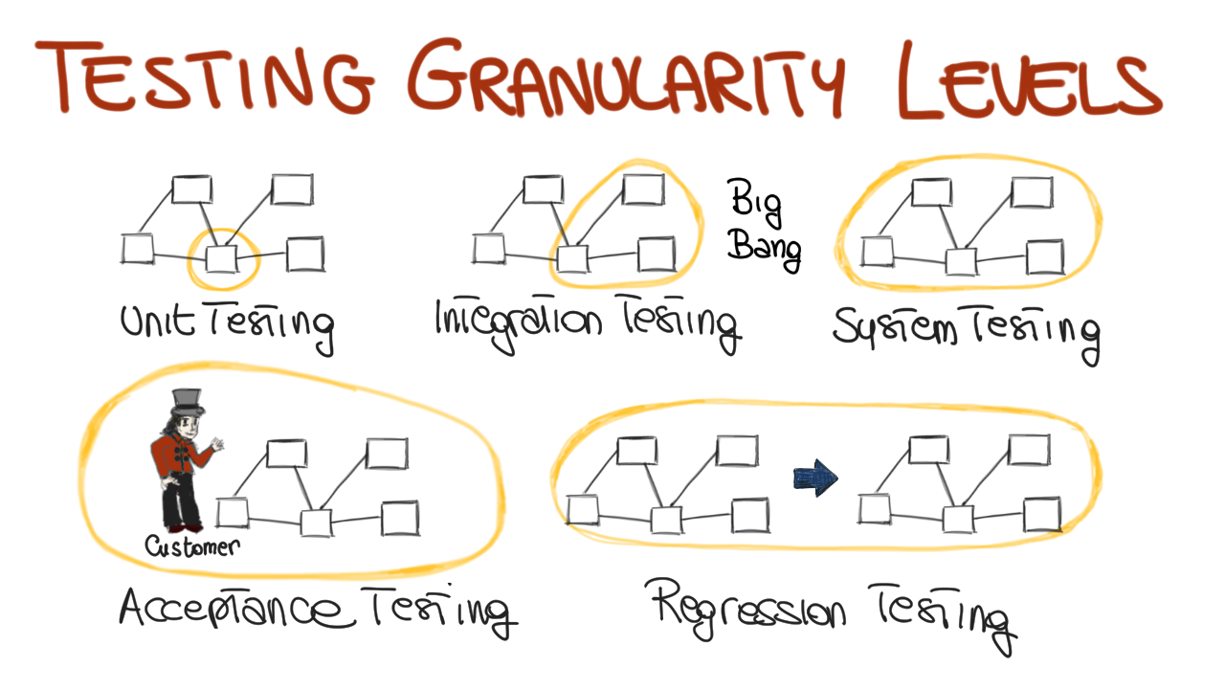

Slide 19
Notes:
Consider a sw system: component that interacts one with the other

Slide 20
Notes:
Interaction among modules
*orders
*whay -> big bang

Slide 22
Notes:
Functional and non-functional (qualities)
Double value example
Performance, load test

Slide 23
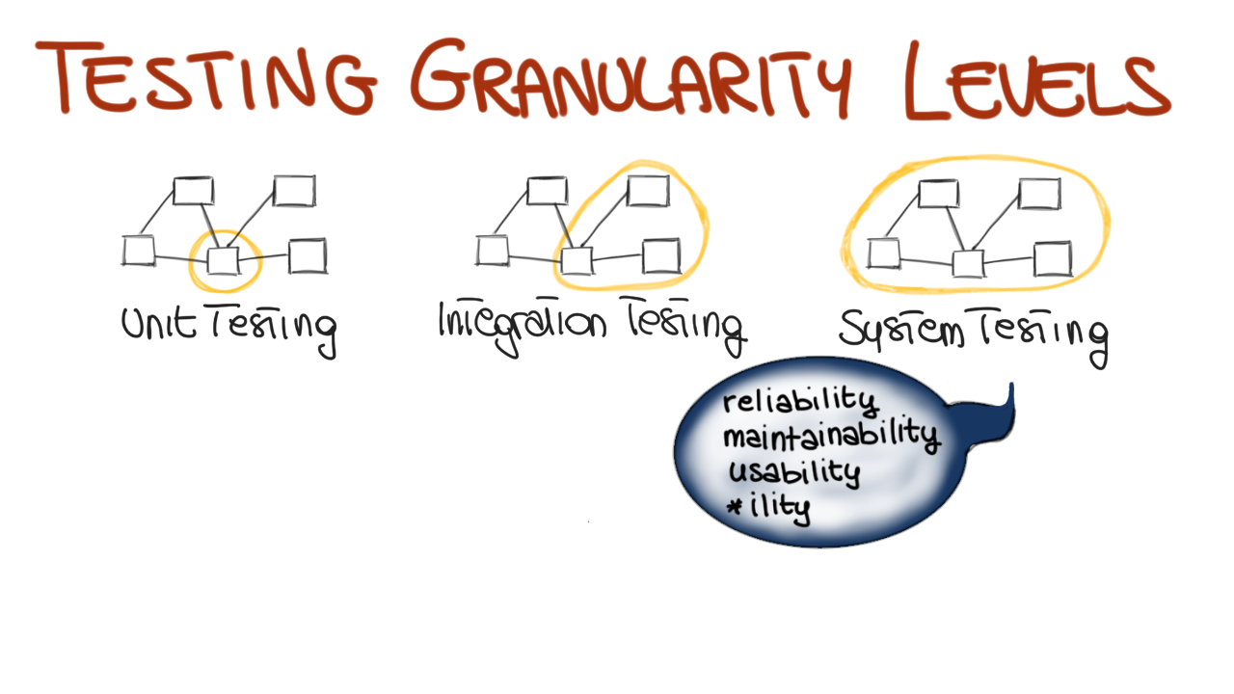

Slide 24
Notes:
Other two levels involving the systems

Slide 25
Notes:
Re-testing: everytime we changes our testing
Part of the code unrelated can be influenced -> regression errors

Slide 26
To do…
Have a plan
Remember that there are different level of granularity
Remember that there are different moment in the development process
Know why you are running a test case?
Know your goals
Coverage level
When to stop
Notes:
… test until the ship-date …
Sometimes called the “date criterion”

Slide 27
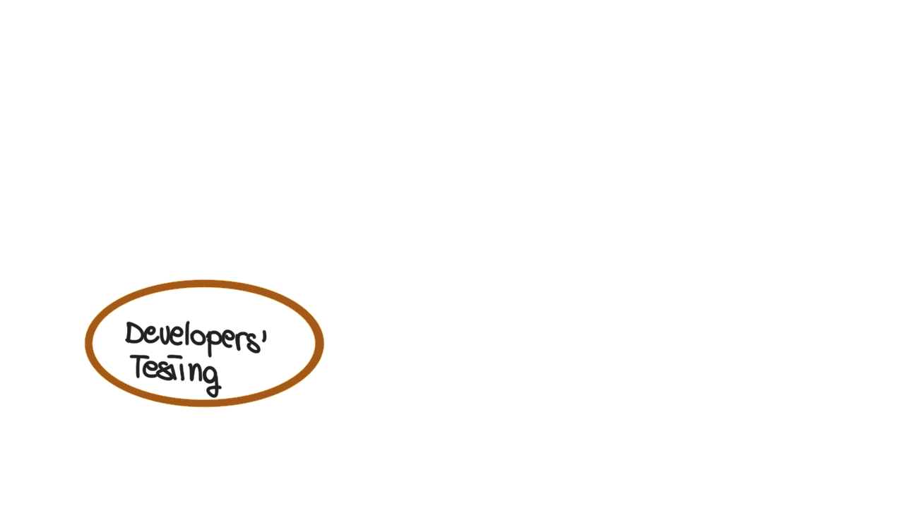
Notes:
All the seen up to this point

Slide 28
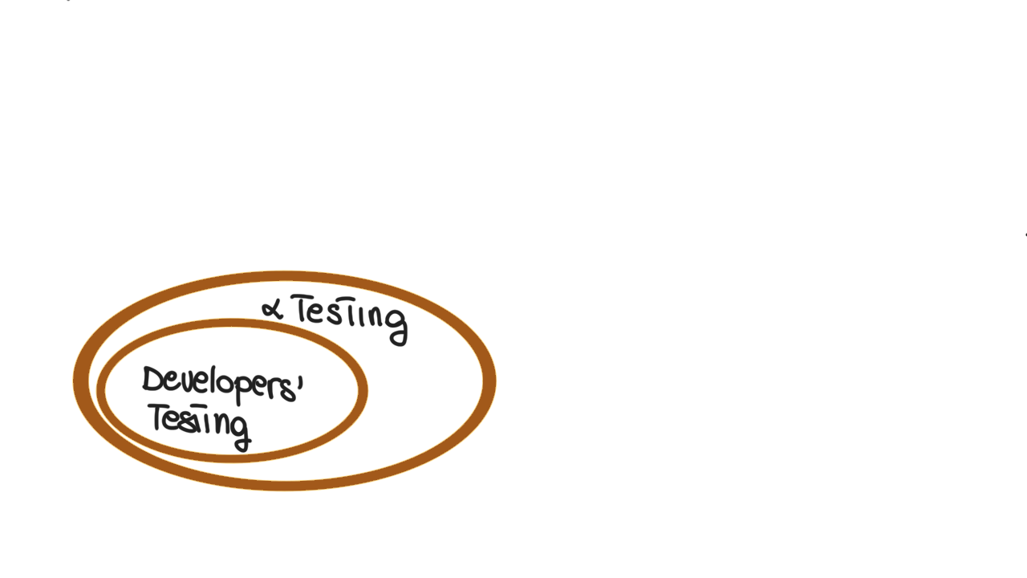
Notes:
Performed to distribute to a set of a user (internal at the organization)

Slide 29
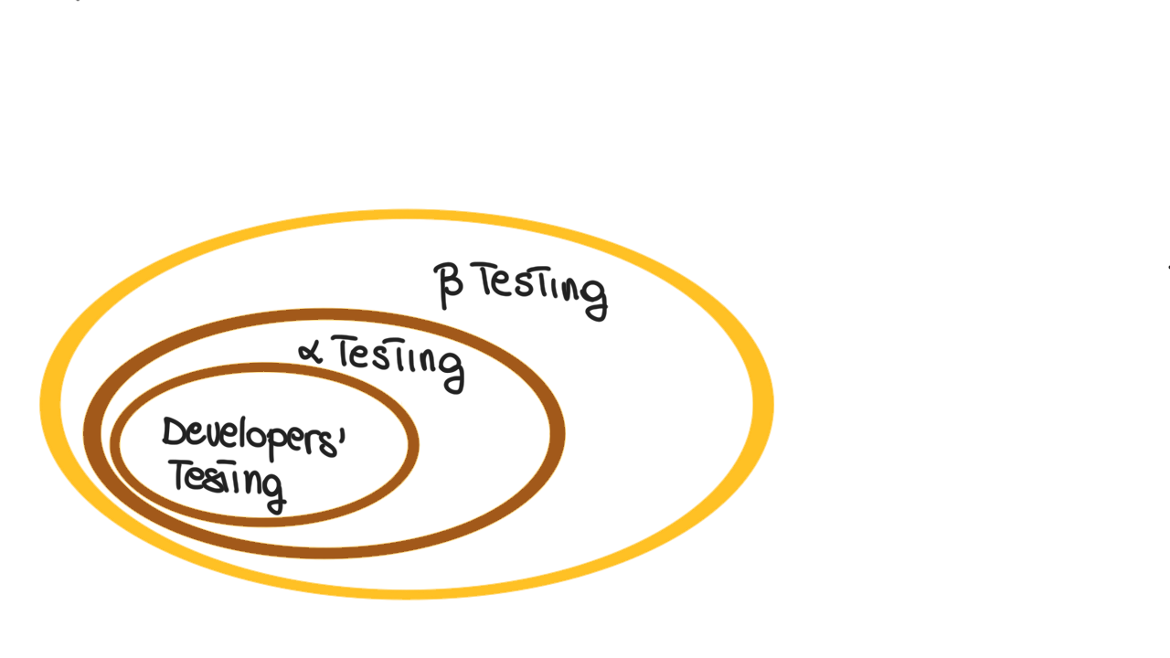
Notes:
Outside organization
Alpha tester have higher tollerance

Slide 30
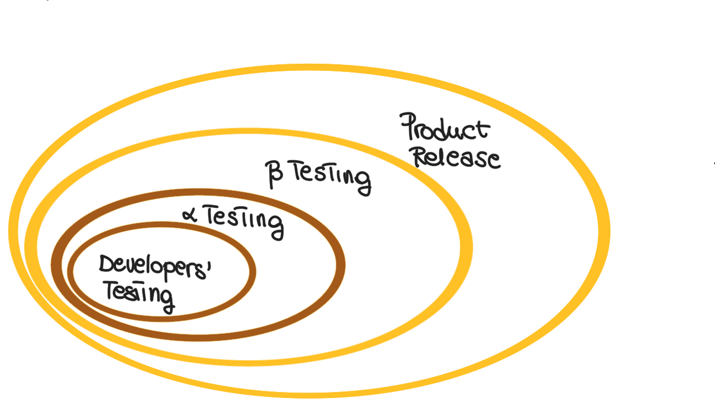

Slide 31
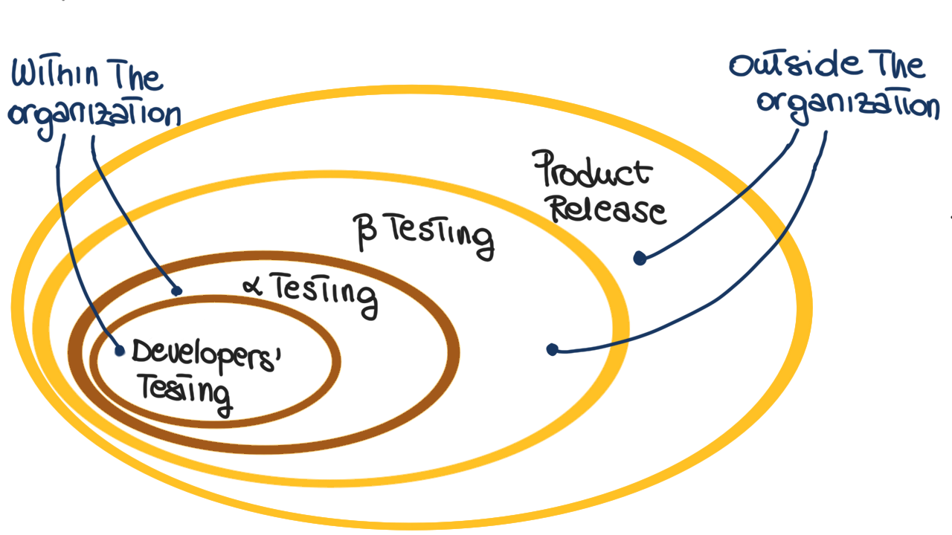

Slide 32
To do…
Have a plan
Remember that there are different level of granularity
Remember that there are different moment in the development process
Know why you are running a test case
Know your goals
Coverage level
When to stop
Notes:
… test until the ship-date …
Sometimes called the “date criterion”

Slide 33
Testing Techniques
There are a number of techniques
Different processes
Different artifacts
Different approaches
There are no perfect techniques
Testing is a best-effort activity
There is no best technique
Different contexts
Complementary strengths and weaknesses
Trade-offs

Slide 34
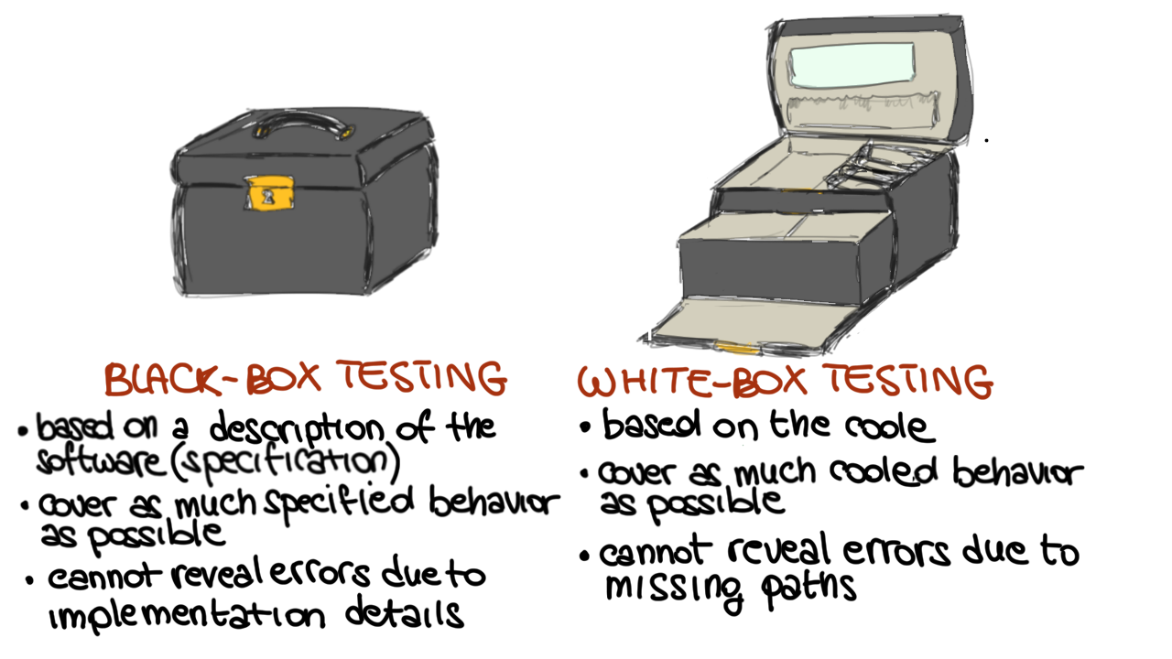
Traditional classification
Notes:
Testing based on the description: try to cover as much as specification behaviors… cannot cover failiure due to code bad behavior
-> white-

Slide 35
Traditional classification

Slide 36
Traditional classification

Slide 37
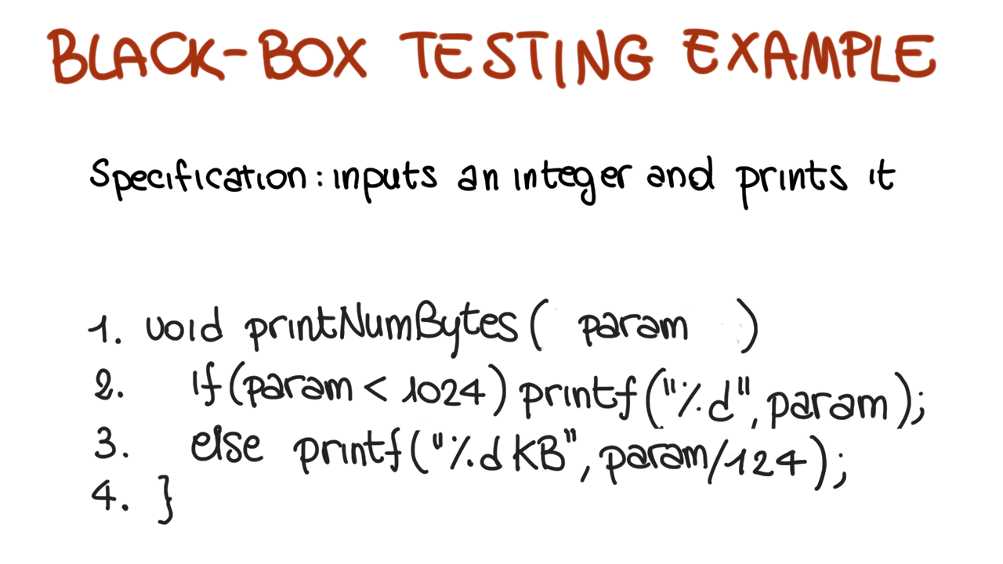
Notes:
Positivo, negativo, 0

Slide 39
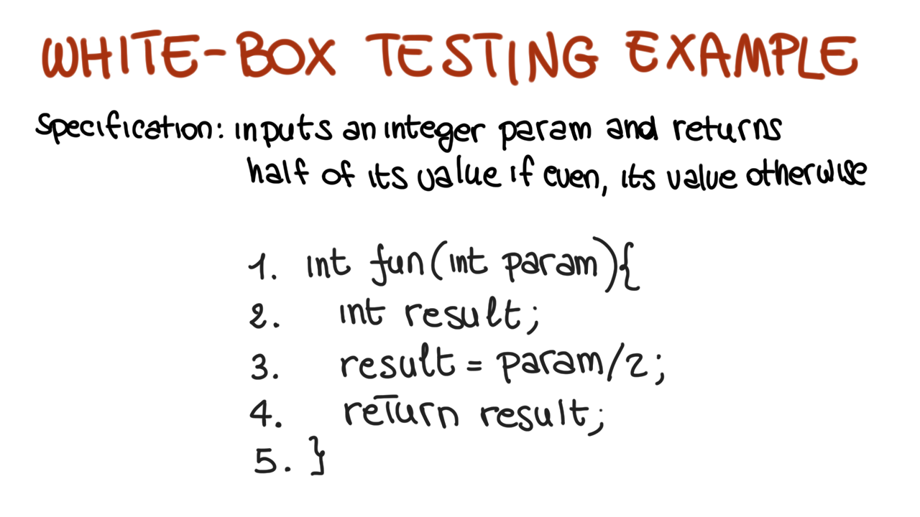
Notes:
Imagine to use random testing and stop when 100% coverage is reached
Function foo works correctly only for even integers
The fault may be missed by structural testing (100% coverage with any value)
The fault would be easily revealed by black-box testing (typically, we would use at least one odd and one even input)

Slide 41
To do…
Have a plan
Remember that there are different level of granularity
Remember that there are different moment in the development process
Know why you are running a test case
Know your goals
When to stop
Coverage level
Notes:
… test until the ship-date …
Sometimes called the “date criterion”

Slide 42
Coverage Criteria
Testers search a huge input space
Goal: Trying to find the fewest inputs that will find the most problems
Coverage criteria give structured, practical ways to search the input space
Search the input space thoroughly
Not much overlap in the tests
Provide traceability from software artifacts to tests
Source, requirements, design models, …
Gives testers a “stopping rule” … when testing is finished

Slide 43
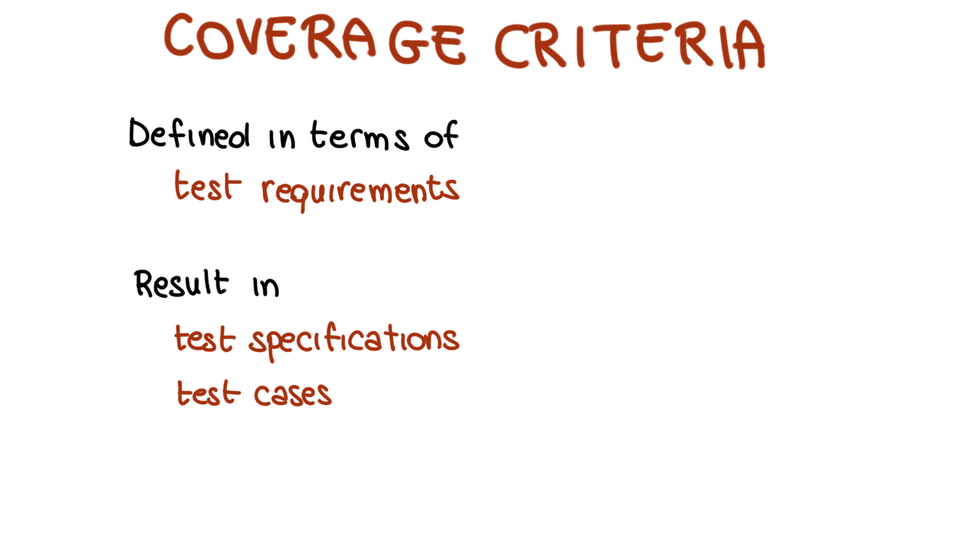
= what we mean as “portion” of “something” = what we want to cover with our test cases
= elements in the “something” that we need to execute
Notes:
Test requirements = elements in the code that we need to execute

Slide 44
What is “something”?
Input domain
Graphs
Code
Models
Logic expressions
Syntax descriptors
How does criteria coverage relate with the traditional classification?

Slide 45
Types of Test Activities
Testing can be broken up into four general types of activities
Test Design
Test Automation
Test Execution
Test Evaluation
No reasonable software development organization uses the same people for requirements, design, implementation, integration and configuration control
Why do test organizations still use the same people for all four test activities??
Notes:
Each type of activity requires different skills, background knowledge, education and training

Slide 46
Test Design
Criteria–based: design test values to satisfy coverage criteria
This is the most technical job in software testing
Requires knowledge of discrete math, programming, and testing
Human-based: design test values based on domain knowledge of the program and human knowledge on testing
Criteria-based approaches can be blind to special situations
Requires knowledge of domain, testing, and user interfaces
Requires almost no traditional CS
A background in the domain of the software is essential
An empirical background is very helpful (biology, psychology, …)
A logic background is very helpful (law, philosophy, math, …)

Slide 47
Test Automation
Embed test values into executable scripts
Requires knowledge of programming
Requires very little theory
Often requires solutions to difficult problems related to observability and controllability
Who is responsible for determining and embedding the expected outputs ?
Test designers may not always know the expected outputs
Test evaluators need to get involved early to help with this

Slide 48
Test Execution
Run tests on the software and record the results
This is easy – and trivial if the tests are well automated
Requires basic computer skills
If, for example, GUI tests are not well automated, this requires a lot of manual labor
Test executors have to be very careful and meticulous with bookkeeping

Slide 49
Test Evaluation
Evaluate results of testing, report to developers
Requires knowledge of :
Domain
Testing
User interfaces and psychology
Usually requires almost no traditional CS
A background in the domain of the software is essential
An empirical background is very helpful (biology, psychology, …)
A logic background is very helpful (law, philosophy, math, …)

Slide 50
Other Activities
Test management : Sets policy, organizes team, interfaces with development, chooses criteria, decides how much automation is needed, …
Test maintenance : Save tests for reuse as software evolves
Requires cooperation of test designers and automators
Deciding when to trim the test suite is partly policy and partly technical – and in general, very hard !
Tests should be put in configuration control
Test documentation : All parties participate
Each test must document “why” – criterion and test requirement satisfied or a rationale for human-designed tests
Ensure traceability throughout the process
Keep documentation in the automated tests

